Slide 1
Advanced Machine Learning
BY
Adnan Amin
http://Geoamins.com

Slide 2
Overview
Course Overview
Fundamental of Machine Learning

Slide 3
Machine Learning?
Informal Definition:
Algorithms that can learn from observational data, and can make predictions based on it.
Machine learning is the practice of computer programming that uses algorithms to learn from data and make intelligent predictions without being explicitly programmed.
Machine learning is a growing technology which enables computers to learn automatically from past data.
That’s pretty much what the human’s brain actually does too.

Slide 4
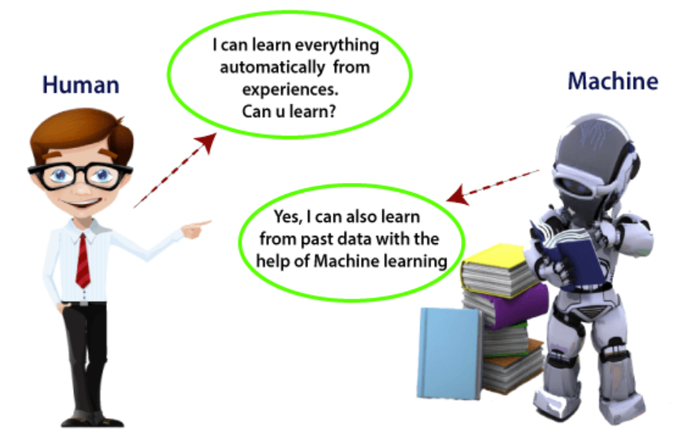
Notes:
https://www.javatpoint.com/machine-learning

Slide 5
The early age of ML
1834 (Charles babbage), the father of modern computer, conceived a device that could be programmed with punch cards, and logical structure.
1936 (Alan Turning), designed a theory that how a machine can determine and execute a set of instructions.
1940 (ENIAC), first electronic general-purpose computer
1950 (Alan Turing), published a paper “Computer Machinery and Intelligence”, on the topic of AI. He asked, Can machine think?

Slide 6
Machine Learning (History)
Machine Learning is said as a subset of artificial intelligence.
AI as we know it has been ofﬁcially founded in 1956 at Dartmouth College, where the most eminent experts gathered to brainstorm on intelligence simulation.
The term machine learning was first introduced by Arthur Samuel in 1959.
Notes:
This happened only a few years after Asimov set his own three laws of robotics, but more relevantly after the famous paper
published by Turing (1950), where he proposes for the ﬁrst time the idea of a thinking machine and the more popular Turing test to assess whether such machine shows, in fact, any intelligence.

Slide 7
ML Should be:
A machine has the ability to learn if it can improve its performance by gaining more data.

Slide 8
Machine Learning
Formal Definition:
Machine Learning is the field of study that gives computers the ability to learn without being explicitly programmed. (Arthur Samuel, 59)
A computer program is said to learn from experience E with respect to some task T and some performance measure P, if its performance on T, as measured by P, improves with experience E. (Tom Mitchell, 97)

Slide 9

Mathematical Notation of Formal Def. 1:
f(X)= algorithm
f(X)→ Y (output)
f(x1, x2, x3)→ y
x1,x2,x3 are features
Notes:
Data→ Algorithms
(algorithms learns from data and perform prediction)
X → Y
(x is input y is output)
e.g., Size of the house (input) → Price of the house (prediction)

Slide 10
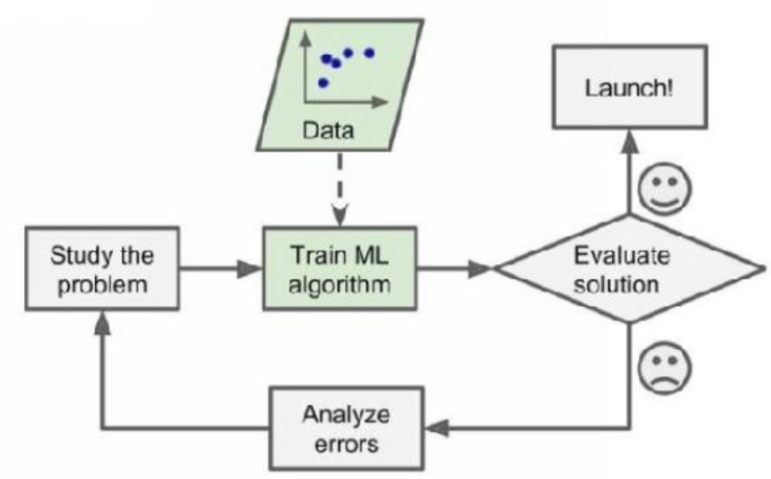
How it works (ML is iterative process)?
Study the problem
Train the algorithm
Evaluate the solution
If it is good, launch it
Else, analyze the errors

Slide 11
Mathematical Notation of Formal Def. 2:
Email Spam Detection System
T= 0 or 1 (Spam yes or no)
E= Experience (learned from previous cases)
P= Performance (Prediction accuracy)
f(X)=algorithm
Evaluate (check the performance)
Launch the system (if performance is good)
Error analysis (go to f(x) and hyperparameter or check)

Slide 12
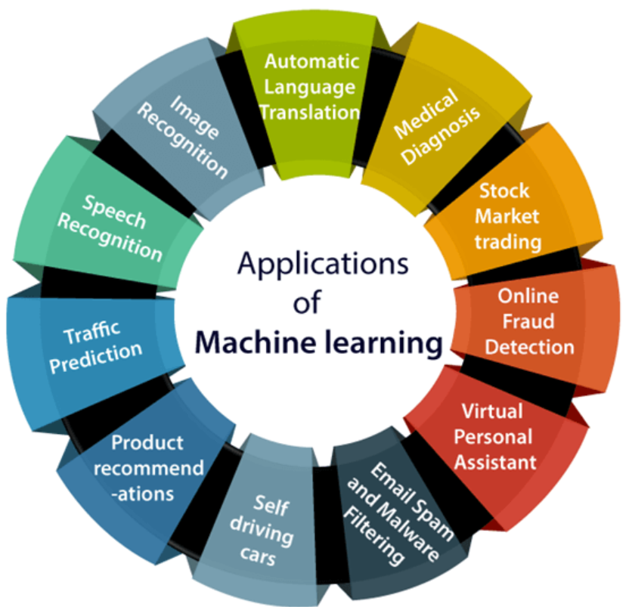
Notes:
https://www.javatpoint.com/applications-of-machine-learning

Slide 13
Types of ML
We can classify machine learning systems according to the type and amount of human supervision during the training. You can find four major categories:
Supervised learning
Unsupervised learning
Semi-supervised learning
Reinforcement learning

Slide 14
1. Supervised learning
In this, we provide sample data, with the desired output (labels) to the machine in order to train it, and on that basis, it predicts the unseen output.
The training data in supervised learning consist of input–output pairs. For each input in the training data, we know its corresponding output, which can be used to guide learning algorithms as a supervision signal.

Slide 15
Supervised Learning
There are two major types of supervised learning:
Classification:
A classification problem is when the output variable is a category, such as red or blue or disease and no disease.
Regression:
A regression problem is when the output variable is a real value, such as dollars or weight, age, height.
Classification aims to predict a discrete class label. Regression, on the other hand, is the challenge of predicting a continuous variable.

Slide 16
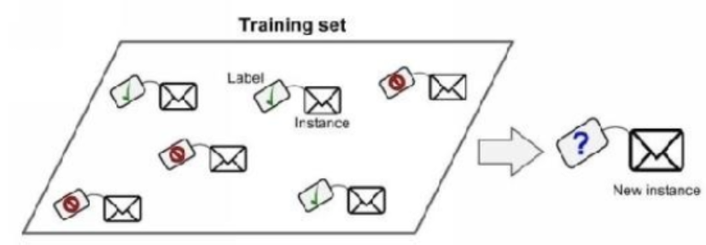
Goal: to map input data with the output data. f(x1) → yi where I is labels.
It is based on supervision, and it is same as when a student learns things in research in the supervision of the research supervisor.

Slide 17
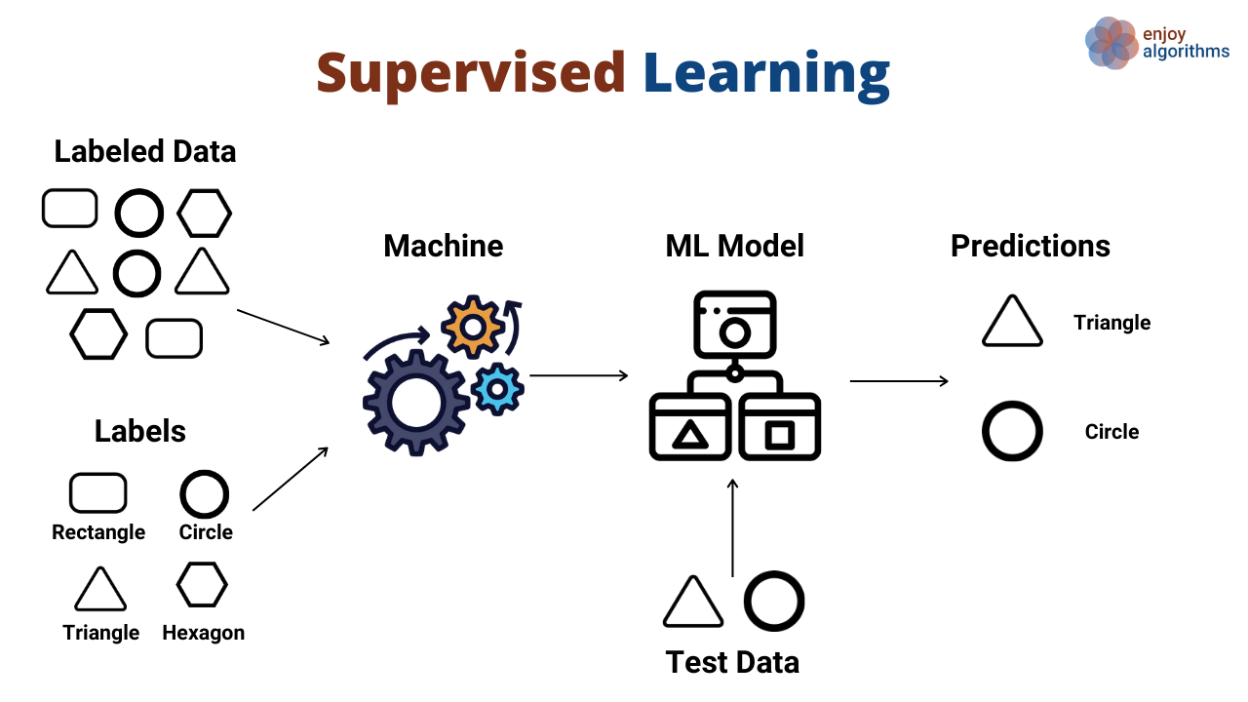

Slide 18
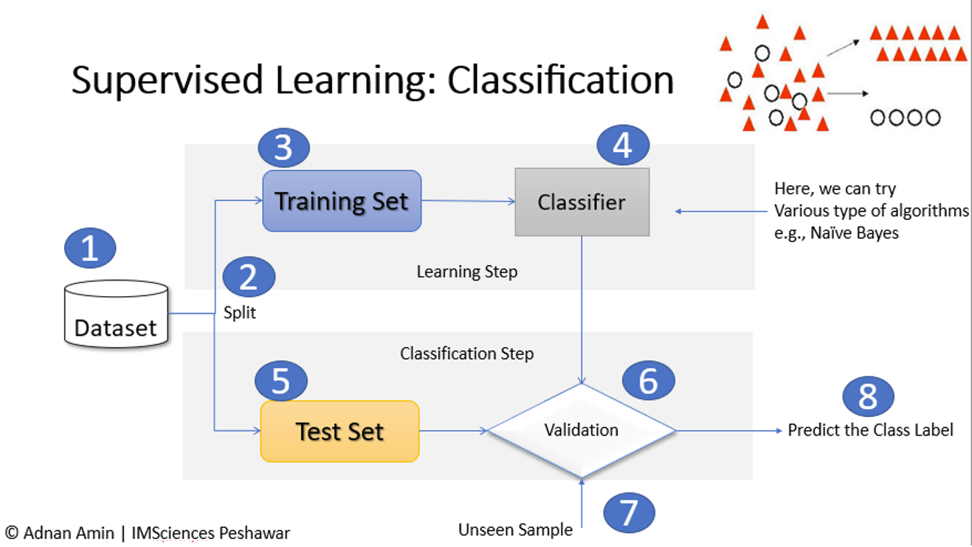
Classification
In ML, classification refers to a predictive modeling problem in which class labels are predicted for a given example of input data.
E.g., Categorizing email as "spam" or "no-spam“
The classification prediction algorithm is evaluated based on the outcomes.
We divide the dataset into training set and testing set.
Reason: we want to test the model after we are done, so a test set is used for evaluating the designed model.

Slide 20
1. Supervised learning (types)
Supervised learning can be categorized into two types of algorithms:
Classification (output will be categorical/interval)
Regression (output will be continuous value)
Well-known supervised algorithm:
K-nears neighbors
Linear regression
Neural networks
Support vector machines
Logistic regression
Decision trees and random forests

Slide 21
E.g. Prediction of house price
Size of the house
Size of the house
f( x1 ) → y
Where x1 is a feature or predictor and y is a label or target variable
Notes:
x1 → y

Slide 22
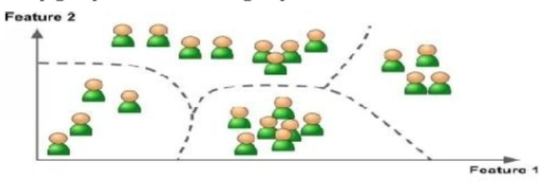
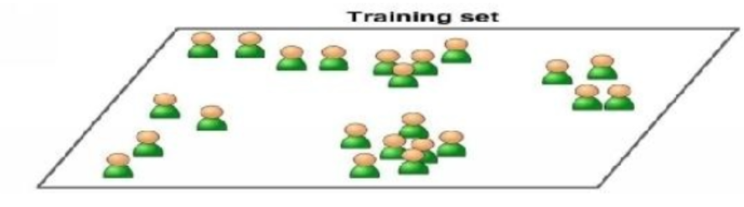
2. Unsupervised Learning
A learning method in which a machine learns without any supervision.
You can guess that the data is unlabeled.
Unsupervised learning sounds awful! Why use it?
Because you don’t know what you’re looking for:

Slide 23
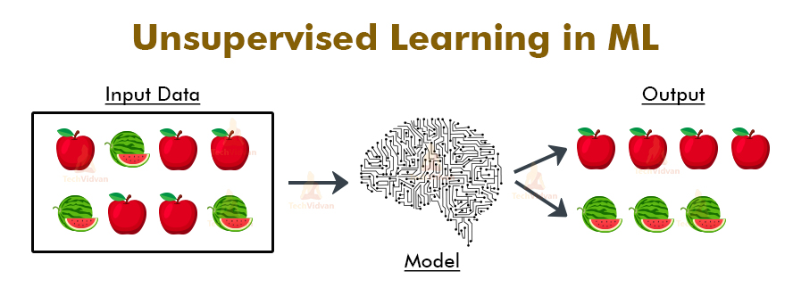

Slide 24
2. Unsupervised Learning (algorithms)
Well-known unsupervised algorithms:
Clustering (k-means, hierarchical cluster analysi)
Association rule learning (Eclat, apriori, FP-Growth)
Visualization and dimensional (PCA)

Slide 25
Supervised vs Unsupervised
In unsupervised learning, it is usually cheaper to collect training data because it does not require extra human efforts to label each input with the corresponding output. But much harder problem because of the lack of supervision information.
In supervised learning, collecting the input–output pairs for supervised learning often requires human annotation, which may be expensive in practice.

Slide 26
3. Semi-supervised Learning
In between these two supervised and unsupervised learning,
we can combine a small amount of labeled data with a large amount of unlabeled data during training.
These learning methods are often called semi-supervised learning.
In special case:
When the true outputs is difficult to or expensive to obtain, we can use other readily available information, which is only partially relevant to the true outputs, as some weak supervision signals in learning.
These methods are called weakly supervised learning.

Slide 27
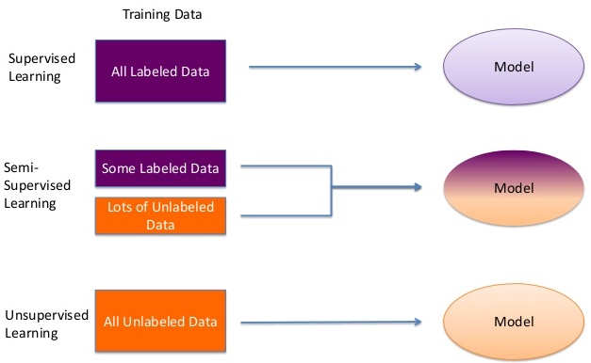

Slide 28
4. Reinforcement Learning
An agent “AI System” will observe the environment, perform given actions, and then receive t rewards in return. With this type, the agent must learn by itself. Ties called a policy.
OR
Reinforcement learning is a feedback-based learning method, in which a learning agent gets a reward for each right action and gets a penalty for each wrong action. The agent learns automatically with these feedbacks and improves its performance. The agent interacts with the environment and explores it. The goal of an agent is to get the most reward points, and hence, it improves its performance.

Slide 29
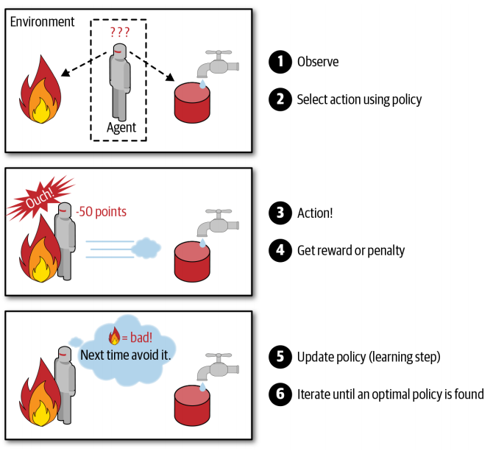

Slide 30
Further ML types
Batch Learning
Online learning
Instance based learning
Model-based learning

Slide 31
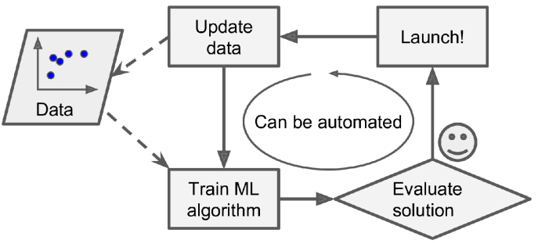
1. Batch Learning ML
In this, the system will require prior all data before training the machine, so it’s always done offline.
The first step to do is to train the system, and then launch it without any learning.

Slide 32
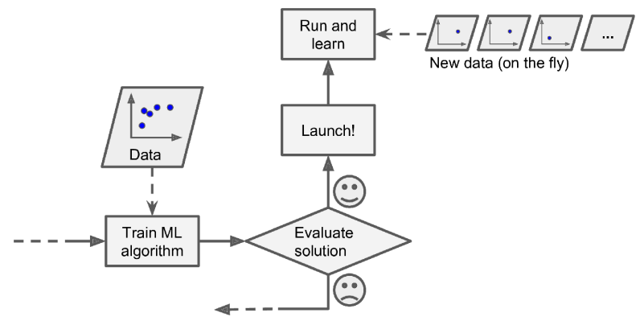
2. Online Learning
The system can learn incrementally by providing the system with all the available data as instances, and then the system can learn on the fly.
In online learning, a model is trained and launched into production, and then it keeps learning as new data comes in

Slide 33
3. Instance-based learning ML
Memory based learning
compares new problem instances with instances seen in training, which have been stored in memory.
Well-known Instance-based learning algorithms
K Nearest Neighbor (KNN)
Self-Organizing Map (SOM)

Slide 34
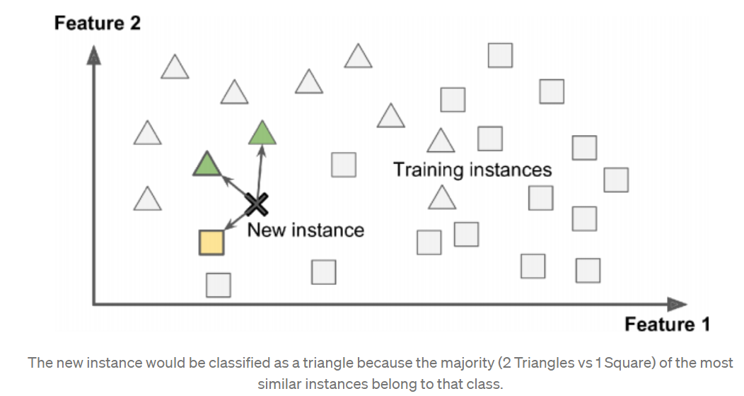

Slide 35
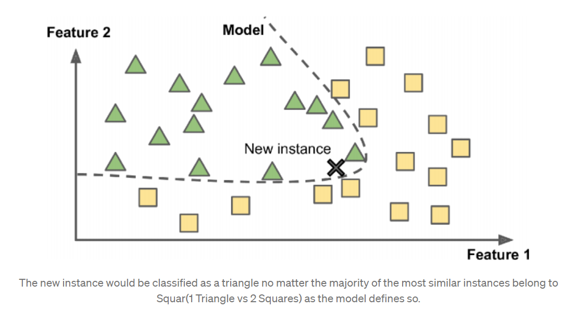
4. Model-Based Learning ML
usually refers to a ML model’s ability to perform well on new unseen data rather than just the data that it was trained on.

Slide 37
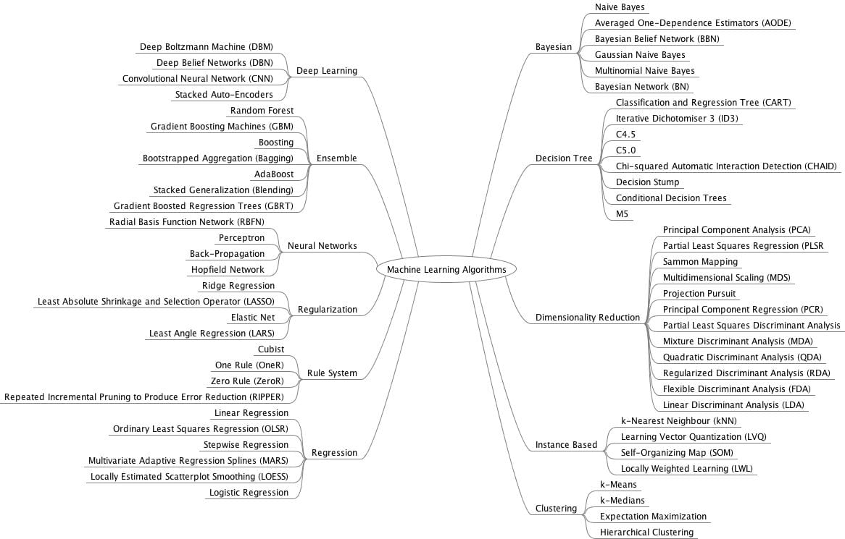
Notes:
https://machinelearningmastery.com/

Slide 38
